Slide 1
9
Chapter
Understanding Groups and Managing Work Teams
Copyright ©2011 Pearson Education

Slide 2
What Is a Group?
Two or more interacting and interdependent individuals who come together to achieve specific goals
Formal ones are work groups that are defined by the organization’s structure
  have designated work assignments and specific tasks directed at accomplishing organizational goals

Slide 3
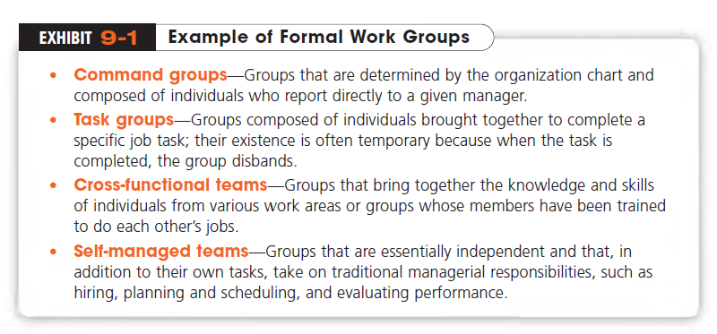
Copyright ©2011 Pearson Education

Slide 4
Current Challenge of Organizational Life
Understanding how groups and teams form, work harmoniously, perform and adjourn gain importance.
Moving in and out of teams
  good use of verbal and non-verbal cues
  listening well, adapting communication to diverse people, constructive climate

Slide 5
Why Do People Join Groups?
Status
Security
Self-esteem
Affiliation
Power
Goal Achievement

Slide 6
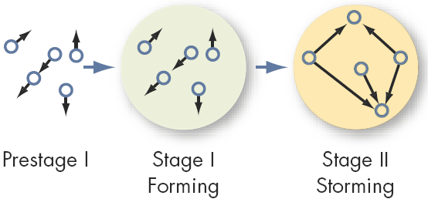
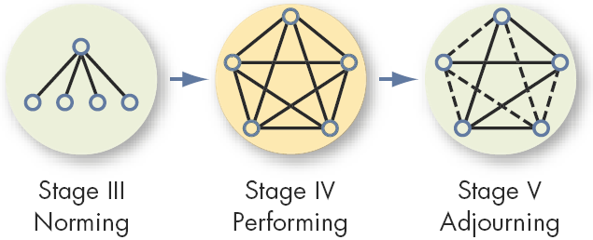
Research shows that groups develop through five stages. Exhibit 9-2, shows these five stages:

Slide 7
The Stages of Group Development
Forming Stage
  The first stage of group development in which people join the group and then define the group’s purpose, structure, and leadership
Storming Stage
  The second stage of group development, which is characterized by intragroup conflict
  There’s conflict over who will control the group and what the group needs to be doing.

Slide 8
Group Development Stages (cont.)
Norming Stage
  The stage of group development, characterized by close relationships and cohesiveness
  There is now a strong sense of group identity and camaraderie.
Performing Stage
  The stage of group development, when the group is fully functional and works on the group task
  Their energies have moved from getting to know each other to working on the group’s task.

Slide 9
Group Development Stages (cont.)
Adjourning Stage
  The final stage of group development for temporary groups, during which groups prepare to disband
  Attention is focused on wrapping up activities instead of task performance

Slide 10
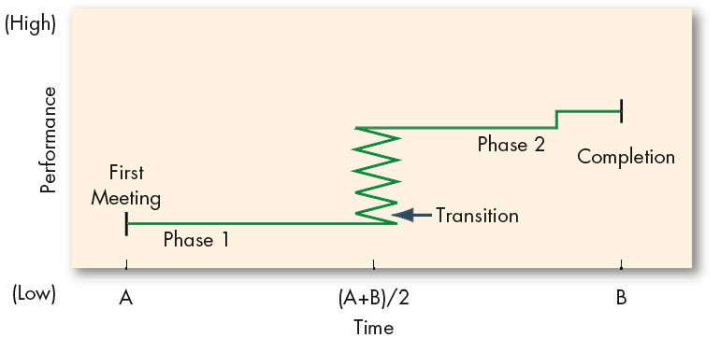
An Alternative Group Formation Model
As group behavior is very complex, progressing through the stages do not always assure effectiveness. High levels of conflict may be conducive to high performance.
Temporary groups with deadlines may use Punctuated-Equilibrium Model:
    Setting group direction
    First phase of inertia
    Half-way point transition
    Major changes
    Second phase of inertia
    Accelerated activity
Notes:
trampoline

Slide 11
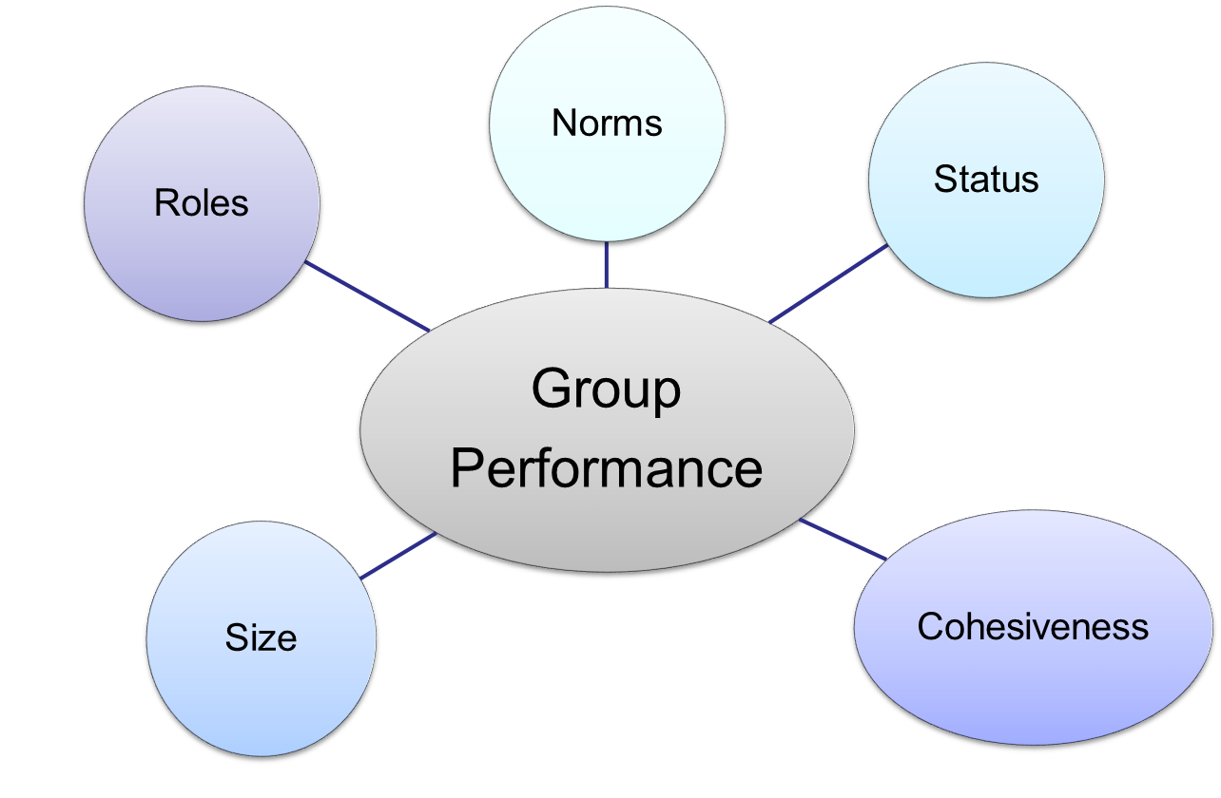
Group Properties

Slide 12
Role
Behavior patterns expected of someone who occupies a given position in a social unit and act in a given situation→ Role Expectations
Role Identity: Certain attitudes and behaviors consistent with a role
Role Perception: An individual’s view of how he or she is supposed to act in a given situation – received by external stimuli
Role Conflict: A situation in which an individual is confronted by contradictory role expectations

Slide 13
A simulation experiment of imprisonment: random assignment of ordinary college students as “Prisoner” or “Guard” for 14 days
Prisoners stayed in jail around the clock. Guards ‘worked’ 8 hour shifts.
“guards” became sadistic, inhumane treatment; “prisoners” began to experience psychological breakdowns, obsessive thoughts of prison-break

Slide 14
Experiment was halted due to concerns after only 6 days
Fell into the roles as they understood them; individuals can do anything as long as it’s consistent with their role identity.
Real world example: Abu Ghraib
Never underestimate the power of situation (or role expectations) to overwhelm personalities and good upbringing.

Slide 15
What Are the Major Concepts of Group Behavior?
Norms
  Standards or expectations that are accepted and shared by a group’s members
  Norms dictate output levels, absenteeism rates, promptness or tardiness, the amount of socializing allowed on the job, and so on.

Slide 16
Norms and Behavior
Conformity
  Gaining acceptance by adjusting one’s behavior to align with the group norms
Reference Groups
  Important groups to which individuals belong or hope to belong and with whose norms individuals are likely to conform
  Asch Studies

Slide 17
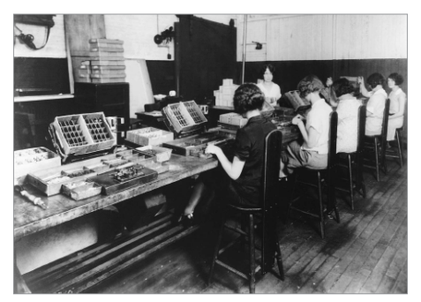
Hawthorne Studies (1924 - 1932)
A series of studies undertaken by Elton Mayo at Western Electric Company’s Hawthorne Works
Research Conclusions
  Worker behavior and sentiments were closely related.
  Group influences (norms) were significant in affecting individual behavior.
  Group standards (norms) were highly effective in establishing individual worker output.
  Money was less a factor in determining worker output than were group standards, sentiments, and security.

Slide 18
Classes of Norms
  Performance norms - level of acceptable work
  Appearance norms - what to wear
  Social arrangement norms - friendships and the like
  Allocation of resources norms - distribution and assignments of jobs and material

Slide 19
Are Cohesive Groups More Effective?
Group Cohesiveness
  The degree to which group members are attracted to one another and share the group’s goals

Slide 20
To increase cohesiveness:
    Make the group smaller.
    Encourage agreement with group goals.
    Increase time members spend together.
    Increase group status and admission difficulty.
    Stimulate competition with other groups.
    Give rewards to the group, not individuals.
    Physically isolate the group.

Slide 21
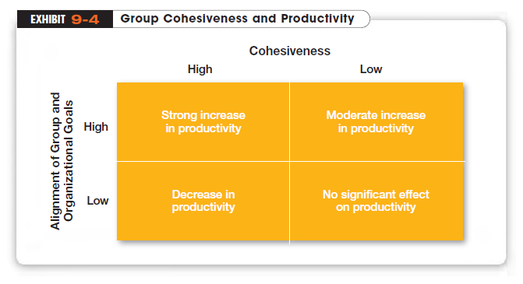

Slide 22
Resisting Norms
Deviant Workplace Behavior
  Also called antisocial behavior or workplace incivility
  Voluntary behavior that violates significant norms and, in doing so, threatens the well-being of the organization
  Typology:
    Production – tardiness, slow-down
    Property – sabotage, stealing
    Political – gossiping, blaming others
    Personal Aggression – verbal abuse, stealing from coworkers

Slide 23
Group Influence on Deviant Behavior
  Group norms can influence the presence of deviant behavior
  Simply belonging to a group increases the likelihood of deviance
  Being in a group allows individuals to hide – creates a false sense of confidence that they won’t be caught

Slide 24
Group Property 3: Status
A socially defined position or rank given to groups or group members by others – it differentiates group members
  Important factor in understanding behavior
  Significant motivator
Status Characteristics Theory
  Status derived from one of 3 sources:
    Power a person has over others
    Ability to contribute to group goals
    Personal characteristics valued
      Good looks, intelligence, friendliness

Slide 25
What Is Status Important?
Status
  A prestige grading, position, or rank within a group
  As far back as scientists have been able to trace human groupings, they’ve found status hierarchies: tribal chiefs and followers, nobles and peasants…
  Status systems are important factors in understanding behavior

Slide 26
Status Effects
On Norms and Conformity
  High-status members are less restrained by norms and pressure to conform
  Some level of deviance is allowed to high-status members so long as it doesn’t affect goal achievement
On Group Interaction
  High-status members are more assertive
  Large status differences limit diversity of ideas and creativity

Slide 27
Does Group Size Affect Behavior?
Large Groups
  are good for gaining diverse input and problem solving
Small Groups
  Are typically faster at implementation and faster task completion
Social Loafing
  The tendency for individuals to expend less effort when working collectively than when working individually

Slide 28
Issues with Group Size
Social Loafing
  The tendency for individuals to expend less effort when working collectively than when working individually
  Caused by either equity concerns or a diffusion of responsibility (free-rider problem)
  More of problem in induvidualistic cultures
Managerial Implications
  Build in individual accountability
  Prevent social loafing by:
    Setting group goals
    Increase intergroup competition
    Use peer evaluation
    Distribute group rewards based on individual effort

Slide 29
Group size affects behavior
  Twelve or more members is a “large” group
  Seven or fewer is a “small” group
Best use of a group:
Attribute | Small | Large
Speed | X
Individual Performance | X
Problem Solving |  | X
Diverse Input |  | X
Fact-finding Goals |  | X
Overall Performance | X

Slide 30
How Are Groups Turned into Effective Teams?
80 percent of Fortune 500 use teams
Teams typically outperform individuals when the tasks require multiple skills, judgment, and experience
Work Teams
  Groups whose members work intensely on specific, common goals using their positive synergy, individual and mutual accountability, and complementary skills

Slide 31
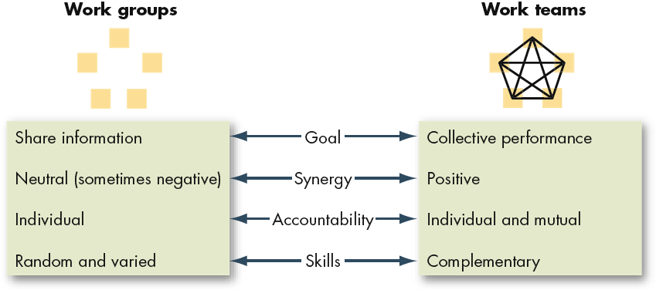
Comparing Work Groups and Work Teams

Slide 32
Types of Work Teams
Problem-Solving Team
  A team from the same department or functional area that’s involved in efforts to improve work activities or to solve specific problems
Self-Managed Work Team
  A type of work team that operates without a manager and is responsible for a complete work process or segment

Slide 33
BUT....
Some organizations have been disappointed with the results from self-managed teams.
  Teams do not seem to work well during organizational downsizing.
  The overall research on the effectiveness of self-managed work teams has not been uniformly positive.
  Moreover, while individuals on teams do tend to report higher levels of job satisfaction, they also sometimes have higher absenteeism and turnover rates.
  The effectiveness of self-managed teams is situation dependent.
Self-Managed Teams
  Do not work well in countries with low tolerance for ambiguity and uncertainty and a high power distance

Slide 34
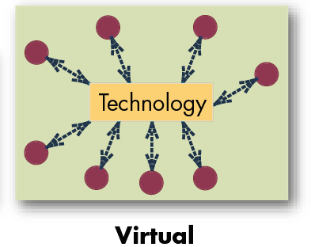
Types of Teams (cont.)
Cross-Functional Team
  Teams made up of individuals from various departments and that cross traditional departmental lines
Virtual Team
  A type of work team that uses technology to link physically dispersed members in order to achieve a common goal

Slide 35
Group Decision Making vs. Individual Choice
Group Strengths:
  Generate more complete information and knowledge
  Offer increased diversity of views and greater creativity
  Increased acceptance of decisions
  Generally more accurate (but not as accurate as the most accurate group member)
Group Weaknesses:
  Time-consuming activity
  Conformity pressures in the group
  Discussions can be dominated by a few members
  A situation of ambiguous responsibility

Slide 36
Group Decision Making Phenomena
Groupthink
  Situations where group pressures for conformity deter the group from critically appraising unusual, minority, or unpopular views
  Hinders performance
Groupshift
  When discussing a given set of alternatives and arriving at a solution, group members tend to exaggerate the initial positions that they hold. This causes a shift to more conservative or more risky behavior.

Slide 37
Differences between Groups and Teams
Work Group
  A group that interacts primarily to share information and to make decisions to help each group member perform within his or her area of responsibility
  No joint effort required
Work Team
  Generates positive synergy through coordinated effort. The individual efforts result in a performance that is greater than the sum of the individual inputs
TEAMS ARE GROUPS BUT NOT ALL GROUPS ARE TEAMS

Slide 38
Teams typically outperform individuals.
Teams use employee talents better.
Teams are more flexible and responsive to changes in the environment
Can quickly assemble, deploy, refocus, and disband
Facilitate employee involvement
Increase employee participation in decision making
Democratize an organization and increase motivation.
Note: teams are not ALWAYS effective

Slide 39
What Makes a Team Effective?
Adequate Resources
  the team’s ability is reduced without adequate resources
Team Leadership and Structure
  all members contribute in the work
Trust
  Team members must trust each
Performance Evaluation and Reward System
  Members have to be accountable both individually and jointly

Slide 40
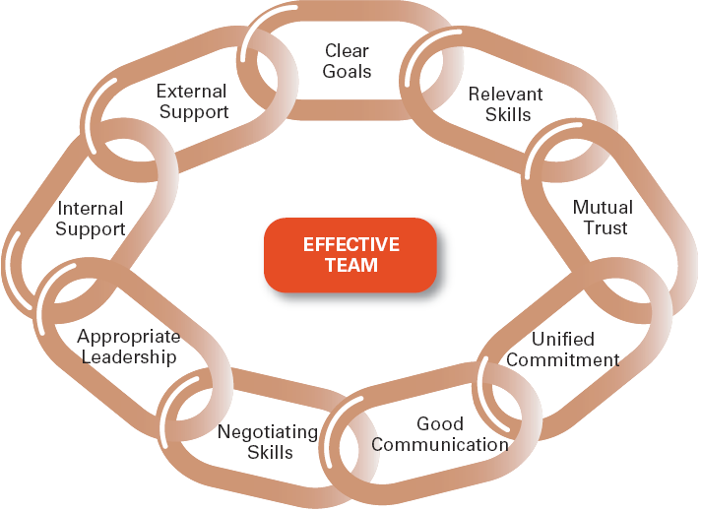
Characteristics of Effective Teams

Slide 41
Key Components of Effective Teams
Context
Composition
Work Design
Process Variables

Slide 42
Creating Effective Teams: Context
Adequate Resources
    Need the tools to complete the job
Effective Leadership and Structure
    Agreeing to the specifics of work and how the team fits together to integrate individual skills
    Even “self-managed” teams need leaders
    Leadership especially important in multi-team systems
Climate of Trust
    Members must trust each other and the leader
Performance and Rewards Systems that Reflect Team Contributions
    Cannot just be based on individual effort

Slide 43
Composition and Team Effectiveness
Abilities of Members
    Need technical expertise, problem-solving, decision-making, and good interpersonal skills
Personality of Members
    Conscientiousness, openness to experience, and agreeableness all relate to team performance
Allocating Roles and Diversity
    Many necessary roles must be filled (creator, organizer, controller..)
    Diversity can often lead to lower performance
Size of Team
    The smaller the better: 5 to 8 is optimal
Member’s Preference for Teamwork
    Do the members want to be on teams?
Notes:
Priceseness

Slide 44
Work Design and Team Effectiveness
These Important work design characteristics enhance team member motivation and increase team effectiveness
  Autonomy
  Using a variety of skills
  Completing a whole and identifiable task or product
Notes:
Several team composition factors are important to a team’s effectiveness. These include team member abilities, personality, role allocation, diversity, size of teams, member flexibility, and member preferences. Part of a team’s performance depends on its members’ knowledge, skills, and abilities.

Slide 45
Creating Effective Teams: Process
Commitment to a Common Purpose
  Create a common purpose that provides direction
  Have reflexivity: willing to adjust plan if necessary
Establishment of Specific Team Goals
  Must be specific, measurable, realistic, and challenging
Team Efficacy
  Team believes in its ability to succeed

Slide 46
Mental Models
  Have an accurate and common mental map of how the work gets done
A Managed Level of Conflict
  Task conflicts are helpful; interpersonal conflicts are not
Minimized Social Loafing (or free-riders)
  Team holds itself accountable both individually and as a team

Slide 47
Processes Related to Effectiveness
Five team process variables have been shown to be related to team effectiveness. These include:
  a common purpose
  specific team goals
  team efficacy
  managed conflict
  minimal social loafing

Slide 48
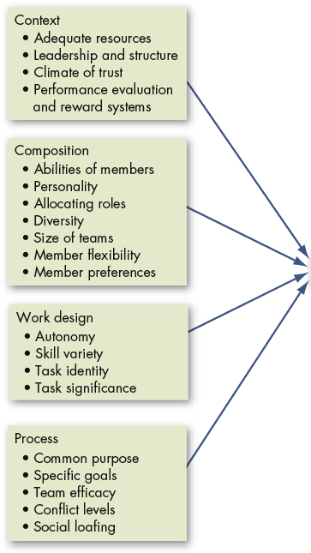

A Team-Effectiveness Model
Caveat 1: This is a general guide only.
Caveat 2: The model assumes that teamwork is preferable to individual work.

Slide 49
Evaluating Group Effectiveness
Performance
  Typically, clear role perception, appropriate norms, low status differences and smaller, more cohesive groups lead to higher performance
Satisfaction
  Increases with:
    High congruence between boss and employee’s perceptions about the job
    Not being forced to communicate with lower-status employees
    Smaller group size

Slide 50
When Are Teams Not the Answer?
Teamwork takes more time and often more resources than does individual work
Teams require managers to communicate more, manage conflicts, and run meetings
The benefits of using teams need to exceed the costs!

Slide 51
Beware!
Teams take more time, resources, etc. than does individual work and they may be vulnerable to ‘groupthink’ or ‘groupshift’.
3 tests to see if a team fits the situation:
  Is the work complex and is there a need for different perspectives: will it be better with the insights of more than one person?
  Does the work create a common purpose or set of goals for the group that is larger than the aggregate of the goals for individuals?
  Are members of the group involved in interdependent tasks?

Slide 52
The Challenges
An employee’s success is no longer defined in terms of individual performance.
  Overcoming individual resistance to team membership.
  Countering the influence of individualistic cultures.
  Introducing teams in an organization that has historically valued individual achievement.
To perform well as team members,
  individuals must be able to communicate openly and honestly,
  to confront differences and resolve conflicts, and
  to sublimate personal goals for the good of the team.
Team cultural diversity and performance
  Diversity caused by national (and other) differences interferes with team efficiency, at least in the short run
  After about three months the differences between diverse and non-diverse team performance disappear

Slide 53
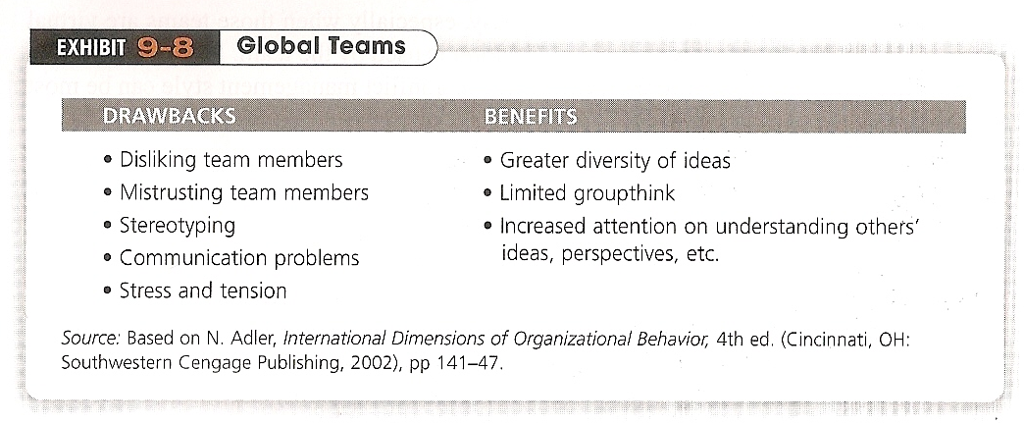
Current Issues which Managers Have to Face

Slide 54
Increase the effectiveness of your team by..
  Establishing a common purpose
  Assess team strengths and weaknesses
  Develop specific individual goals
  Get agreement on a common approach for achieving goals-means
  Encourage acceptance of responsibility for both individual and team performance

Slide 55
  6. Build mutual trust among members
  7. Maintain an appropriate mix of team member skills and personalities
  8. Provide needed training and resources
  9. Create opportunities for small achievements

